Slide 1
Generative AI
Adapted from the slide deck, “Talking to Students about Generative AI” by Jen Easter and Paula Demacio
Notes:
GenAI tools are new for all of us, teachers and students alike! And, GenAI tools are not only here to stay, they are rapidly evolving. Approaching this as an opportunity to learn along with your students sets the stage for a meaningful, ongoing learning experience for everyone.

Slide 2
Let’s Learn Together
GenAI Tools – what are they and how do they work?
What are the limitations and concerns?
What do you need to know about using GenAI tools in this course?

Slide 3
What Do You Know About GenAI Tools? (ChatGPT, Bing Chat, Dall-e, etc)
Notes:
Facilitate a discussion around this topic.
What do you know about GenAI tools?
How do they work? Where do they get their information?
What types do you know about?
Have you used them before? In what ways?

Slide 4
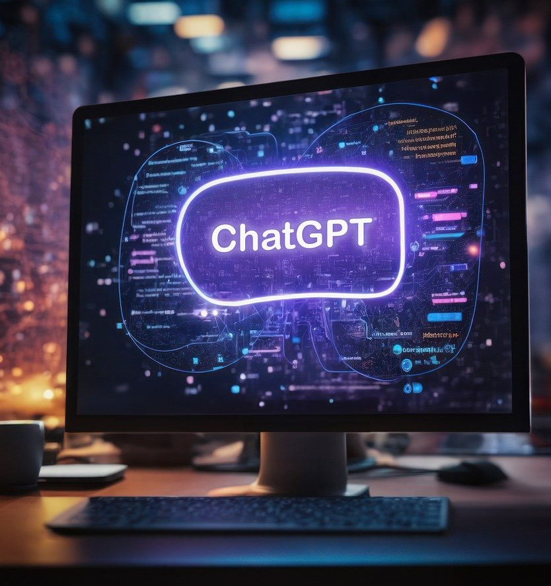
What Is Gen AI?
Generative AI (GenAI or GAI) is a type of artificial intelligence that uses machine learning algorithms to produce, copy or rework content.
This content output can be:
text
Images
audio
code
other formats
Notes:
Generative AI references a newer set of artificial intelligence tools that are able to generate original content in the form of text, audio, video, imagery, code, simulation and more. Generative AI tools are created upon large language models (LLM’s) with GPT being the most popular. LLMs are trained on large data sets of knowledge including natural language processing models that help its outputs mimic natural human spoken text.
How does it work?
When interacting with a generative AI tool, you are essentially interacting with a chatbot in a two way conversation. You, as the user, ask it a question or give it a task, commonly referred to as a prompt. In return, the GAI tool will search through its datasets and using a predictive text model, string together sentences that are most related to your prompt.
From here, you are able to continue the conversation by asking the GAI to refine its output or to generate additional outputs based on your prompts. As you can imagine then, the quality and level of detail within your prompt will greatly affect the output.

Slide 5
GenAI In The Workforce
How has AI impacted your discipline/profession?
What AI skills will you need as you enter the workforce?
Notes:
Facilitate a discussion around this topic.
How has AI impacted your discipline/profession?
What AI skills will you need as you enter the workforce?
Future of Jobs Report (2023): https://www3.weforum.org/docs/WEF_Future_of_Jobs_2023.pdf?_gl=1*19ubrm7*_up*MQ..&gclid=CjwKCAjwjaWoBhAmEiwAXz8DBQ7_9vypwVThhXUyS8_xzwBnHiPBP6dXnXtZMrrXI4-fFtgkusqMGhoCTuEQAvD_BwE

Slide 6
Limitations and concerns
What are some limitations of GenAI tools?
What concerns are there surrounding GenAI?
Notes:
Consider using an interactive activity such as Padlet, mentimeter, zoom chat, etc
What are some limitations of GenAI tools?
What concerns are there surrounding GenAI?

Slide 7
Legal And Ethical Issues Around GenAI
Misinformation: GenAI tools make stuff up (including quotes and references) (NY Times)
Bias and harm: The images it produces can be biased, offensive and perpetuate racial, gender, and age stereotypes (The Conversation). Selection bias - the AI algorithm can produce biased outputs if the data is not diverse or representative. For example – Bing says that the highest scoring football player is Ronaldo, but Christine Sinclair has scored more goals.
Copyright concerns: ChatGPT uses material taken from the internet, generally without the permission of the authors. It has been argued that ChatGPT is "copyright laundering" -- "making works derivative of existing material without breaking copyright". There are lawsuits pending!
Disclosing protected information: It may be unlawful to enter material using the chat function of a GenAI app if the material is protected by laws, such as: privacy laws, intellectual property laws, or otherwise confidential (e.g., a court order). Be cautious what personal information you share.
Traumatizing work to prepare data sets for AI: employing workers from the global south
Ecological impact: emissions produced to power AI
Notes:
https://ghostwork.info
https://time.com/6247678/openai-chatgpt-kenya-workers
https://www.weforum.org/agenda/2023/04/balancing-ais-carbon-footprint-and-its-potential-for-transformative-positive-climate-impact/
https://aiindex.stanford.edu/report/

Slide 8
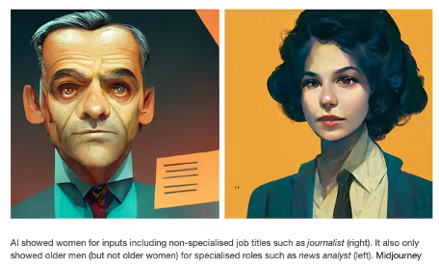
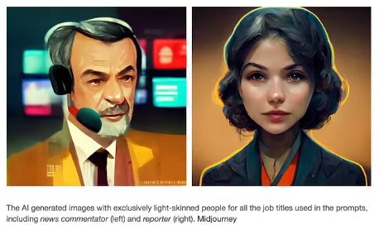
Example Bias
Midjourney:
Showed only older men for “news analyst”, but women can be “journalists”.
Midjourney:
Only light-skinned people for “news commentator”.

Slide 9
Academic Integrity
According to VCC’s institutional response to ChatGPT, VCC’s academic integrity policy still applies to student work that uses AI tools. This means that VCC expects honesty, integrity, truthfulness and proper use of citation and references in the submission of course work.

Slide 10
How has Gen-Ai helped you?
Students might explore using generative AI to:
Be more efficient with course work and tasks
Help with studying
Generate ideas for brainstorming
Get further explanation of a topic a teacher is covering for class
Improve their writing
Get instant feedback
Practice language skills in a safe environment

Slide 11
Using GenAI In This Course
Notes:
INSERT COURSE POLICY _ or have discussion about how students think it could be used ethically and effectively in the course.
Consider co-creating classroom agreement on Gen AI use (templates available on the CTLR GenAI page: https://ctlr.vcc.ca/teaching-and-learning/ai-tools-and-instructional-design/) in the section “How do I address GenAI use in my class?”

Slide 12
Check your use of GenAI:
Is it ethical?
Is it effective?

Slide 13
Student Responsibility for using ai
Citation
Any information taken from ChatGPT needs to be cited! These include MLA, APA, and Chicago Style.
If required, copy and paste all AI interactions at end of assignment
Critical Analysis
If it’s in your paper, you are responsible for it (accuracy, appropriateness, currency, etc.). Evaluate your sources

Slide 14
Faculty Responsibility for using ai
Provide transparent communication on each assignment about when/how/why you can use GenAI
Provide alternatives to address concerns and/or access issues (you will not be mandated to use AI)
Eg: Byte (no account required) or Perplexity
Provide support around effective use of the tools
Share resources
Follow ethical use such as not submitting your assignments to GenAI for grading purposes

Slide 15
Help Resources
When in doubt, ask!
You should seek guidance from your instructor if you have any questions or concerns about the use of AI tools in an assignment. If you have questions about how to cite AI tools, you can make an appointment with a librarian or book an appointment with a tutor in the Learning Centre
Remember, GenAI permissions will be different for each class. Be sure you understand the situation for each of your courses!!

