Slide 1
[Insert Course name] and genAI
VCC CTLR May 2024
Notes:
We are all at different stages on our understanding and use of GenAI, teachers and students alike! And, GenAI tools are not only here to stay, they are rapidly evolving, affecting educationand the workplace. Approaching this as an opportunity to learn together, while ensuring that everyone engages meanginfully with the learning int his course. Want to ensure students are supported for succes in following academic integrity in this course, possibly learning a bit how to use it to be more successful as a stuent, and be prepared with skills for the workforce.

Slide 2
Let’s Learn Together
GenAI – what is it?
How is AI impacting our industry/discipline?
What are the benefits? What are the concerns/risks?
Academic integrity and AI
AI course policy
Keep learning – more resources
Notes:
This discussion wont cover everything or make you an expert in generative AI, but its an opening.

Slide 3
What Do You Know About Gen AI? (ChatGPT, Copilot, Dall-E, etc)
Notes:
ACTIVITY 8 MIN> Use Think Pair Share, Discussion, or group activity of generating a list/visual mindmap + gallery walk
What do you know about GenAI tools?
Have you used them before? In what ways?

Slide 4
What Is Gen AI?
Generative AI (GenAI or GAI) is a type of artificial intelligence that uses machine learning algorithms to generate original content through conversation with a chatbot. Trained on a data set called a large language model LLM.
Tools can output:
text
images
audio
video
code
other formats
Notes:
Generative AI references a newer set of artificial intelligence tools that are able to generate original content in the form of text, audio, video, imagery, code, simulation and more. Generative AI tools are created upon large language models (LLM’s) with GPT being the most popular. LLMs are trained on large data sets of knowledge including natural language processing models that help its outputs mimic natural human spoken text.
How does it work?
When interacting with a generative AI tool, you are essentially interacting with a chatbot in a two way conversation. You, as the user, ask it a question or give it a task, commonly referred to as a prompt. In return, the GAI tool will search through its datasets and using a predictive text model, string together sentences that are most related to your prompt. But it also has randomness. The same prompt will return different answers.
From here, you are able to continue the conversation by asking the GAI to refine its output or to generate additional outputs based on your prompts. As you can imagine then, the quality and level of detail within your prompt will greatly affect the output.

Slide 5
What’s happening in our industry with Gen AI?
Insert some key points
Notes:
Give a brief overview of changes youre seeing professionally in industry or discipline related to this course? How wil it affect students future work? Highlight How will this course will help prepare students to respond to AI?
Future of Jobs Report (2023): https://www3.weforum.org/docs/WEF_Future_of_Jobs_2023.pdf?_gl=1*19ubrm7*_up*MQ..&gclid=CjwKCAjwjaWoBhAmEiwAXz8DBQ7_9vypwVThhXUyS8_xzwBnHiPBP6dXnXtZMrrXI4-fFtgkusqMGhoCTuEQAvD_BwE

Slide 6
Some Good General principles for Using AI:
https://lx.uts.edu.au/collections/artificial-intelligence-in-learning-and-teaching/resources/five-principles-for-effective-ethical-use-generative-ai/
Notes:
Student-centred principles (this could also be rephased to “EVERYONE”)
The following graphic details the five student-centred principles to guide usage of GenAI.
Students understand the significance of GenAI for society, careers, and studies.
Students understand legitimate use of GenAI in their studies.
Students are equipped to engage critically and ethically with GenAI.
Students experience GenAI’s strengths and limitations as aids to learning.
Students are assessed on what they need to know in an AI world.

Slide 7
Risks, concerns, and limitations?
What risks, concerns and/or limitations of GenAI tools like Copilot, ChatGPT, Dall-E, etc. do you know of?
Notes:
5 minutes Students could also use their devices to look these up!!
What are some limitations of GenAI tools?
What concerns are there surrounding GenAI?
“All data are biased, and you can approach tools in an ethical and responsible way.”

Slide 8
Legal And Ethical Issues
Misinformation: AI tools can and do “hallucinate” or “lie” (NY Times). BC lawyer fined for citing cases that don’t exist. Australian academics wrongly accused four firms of ethical misconduct based on AI generated content. Gemini, ChatGPT and Copilot all have disclaimers on the accuracy of information output.
Bias and harm: Images it produces can be biased, offensive and perpetuate racial, gender, and age stereotypes (The Conversation) based on training data (primarily in standard American English). Selection bias - the AI algorithm will produce biased outputs if the data is not diverse or representative. Language bias (most internet data is primarily written in English), UNeSCO research shows a strong tendency to reinforce gender stereotypes and stereotypes based on race.

Slide 9
Example Bias
Midjourney:
Showed only older white men wearing glasses for professors, pretty thin women for customer service
Copilot:
“Create a picture of Canadian family” (all white, two families with opposite sex parents and one with same sex parents, all nuclear families- no intergenerational)
https://www.techfinitive.com/features/what-200-job-images-reveal-about-bias-in-ai/
https://www.vpnmentor.com/blog/ai-generated-images-research/
Notes:
Midjourney article showing race and gender bias https://www.techfinitive.com/features/what-200-job-images-reveal-about-bias-in-ai/

Slide 10
Legal and ethical concerns
Copyright concerns: GenAI models use material taken from the internet, generally without the permission of the authors and artists. It has been argued that ChatGPT is "copyright laundering" –by artists and authors, NYTimes, Sony music . Copyright concerns about uploading academic papers into chatgpt to summarize.
Disclosing protected information: It may be unlawful to enter material using the chat function of a GenAI app if the material is protected by laws, such as: privacy laws, intellectual property laws, confidential organization data, or otherwise confidential (e.g., a court order). Be cautious what personal information you share. Samsung's ChatGPT Leak: AI Risks in the Workplace. Amazon bans ChatGPT to protect internal company data.
Notes:
Generative AI ChatGPT Can Disturbingly Gobble Up Your ...
Forbes
https://www.forbes.com › Innovation › AI
Jan 27, 2023 — According to recent news reports, Amazon apparently discovered that some employees were entering various proprietary information into ChatGPT.
Samsung’s ChatGPT leak Samsung's ChatGPT Leak: AI Risks in the Workplace

Slide 11
Other ethical concerns
Labour required to prepare data sets for AI model training: employing workers from the global south to scrape harmful images and text from the data set.
Ecological impact: Concerns about emissions (carbon footprint) produced to power AI and water usage globally to cool the servers as they continue operating. Estimate 500 mL (2 cups) used for every 20-50 prompts. Making an image with GenAI uses as much energy as charging your phone.
Equity: Do students have equal access to generative AI tools? If a student cannot afford the paid version, are they placed at an educational disadvantage?
Notes:
AI’s Impact on the Environment: Classroom Guide & Discussion Questions.
Understanding the Environmental Impact of AI and GenAI.

Slide 12
What benefits does Gen-Ai offer?
Notes:
Students might explore using generative AI to: ask them to share out? Demo using copilot to ask you questions for studying?

Slide 13
What people are excited about with AI and education
Aid diverse learners with different learning abilities, linguistic backgrounds or accessibility needs.
Be My Eyes uses Open AI’s GPT-4 to transform visual accessibility by generating descriptions of a photo the person has taken, like instructions for setting up a new computer or a product label. Through AI-based natural language conversations, the tool also provides contextual, advice-based guidance to help users through various issues.
Supporting executive functioning for neurodiverse students goblin.tools
Personalized tutoring, explanation, examples etc.
Spark creativity, new ways of thinking

Slide 14
How You Can Use AI as a learning support
Organize study time and break projects down into smaller tasks
Help with studying (create quizzes, ask it to tutor you, give you examples)
Generate ideas for brainstorming
Get further explanation of a topic a teacher is covering for class
Create vocabulary list, study guides
Improve your writing (check with instructor if this is for an assignment)
Create images, videos, code, music for projects
https://teaching.cornell.edu/generative-artificial-intelligence#Upside
Notes:
HERE DEMO USING COPILOT TO HELP STUDY _ SHARE STUDENT PROMPTS https://educational-innovation.sydney.edu.au/teaching@sydney/prompt-engineering-for-students-making-generative-ai-work-for-you/

Slide 15
Academic Integrity
How does VCC’s academic integrity policy relate to generative AI use for assignments/assessments? “VCC expects students to demonstrate honesty and integrity in their academic work.” “VCC reserves the right to review all academic work submitted by a student for authenticity and originality; such review may include but is not limited to the use of software tools and third-party services including internet-based services.”
Notes:
According to VCC’s institutional response to ChatGPT, VCC’s academic integrity policy still applies to student work .This means that VCC expects honesty, integrity, truthfulness and proper use of citation and references in the submission of course work. AI use without permission, can be considered to violate the policy of originality and authenticity in student work. Opportunity to do a case study roleplay:

Slide 16
Scenarios (Optional)
Scenario 1: Amanda has to write a summary of current trends in baking. She uses Copilot to search and summarize information from various sources. She copies/pastes the information into a word document and hands it in with the list of sources used. Is this a case of academic misconduct?
Scenario 2: Luis uses Gemini to create a variety of test questions based on his biology notes from class and the learning objectives. He tests himself on his understanding. Is this a case of academic misconduct?
Scenario 3: Alex uses Copilot to brainstorm ideas for their persuasive essay and help create an outline. They write a draft of the essay and then ask Copilot to provide feedback (the prompt is to provide critical feedback, not to rewrite the essay). on how they could improve their essay. They read each suggestion and decide how to respond to the feedback. They hand in a final draft of their essay. Is this a case of academic misconduct?
Scenario 4: Tian is working on an assigned report that requires analyzing a set of charts and graphs. Tian uploads photos of each chart and graph into ChatGPT Plus and asks for a description and analysis of the images. Tian inserts the output from ChatGPT plus into the report and submits it. Is this a case of academic misconduct?

Slide 17
Our Course AI USE Policy
Where and when do you think it’s okay to use AI in your assignments? How might it impact your learning?
Is it “fair” if some students can afford to pay for certain tools (ChatGPT Plus, Gemini, etc.) and others can’t?
Include/discuss syllabus language here OR Co-create it here with class.
Pedagogical reasons for choice aligned with CLOs and real world
Notes:
Consider Leon Furze’s AI scale of assessment

Slide 18
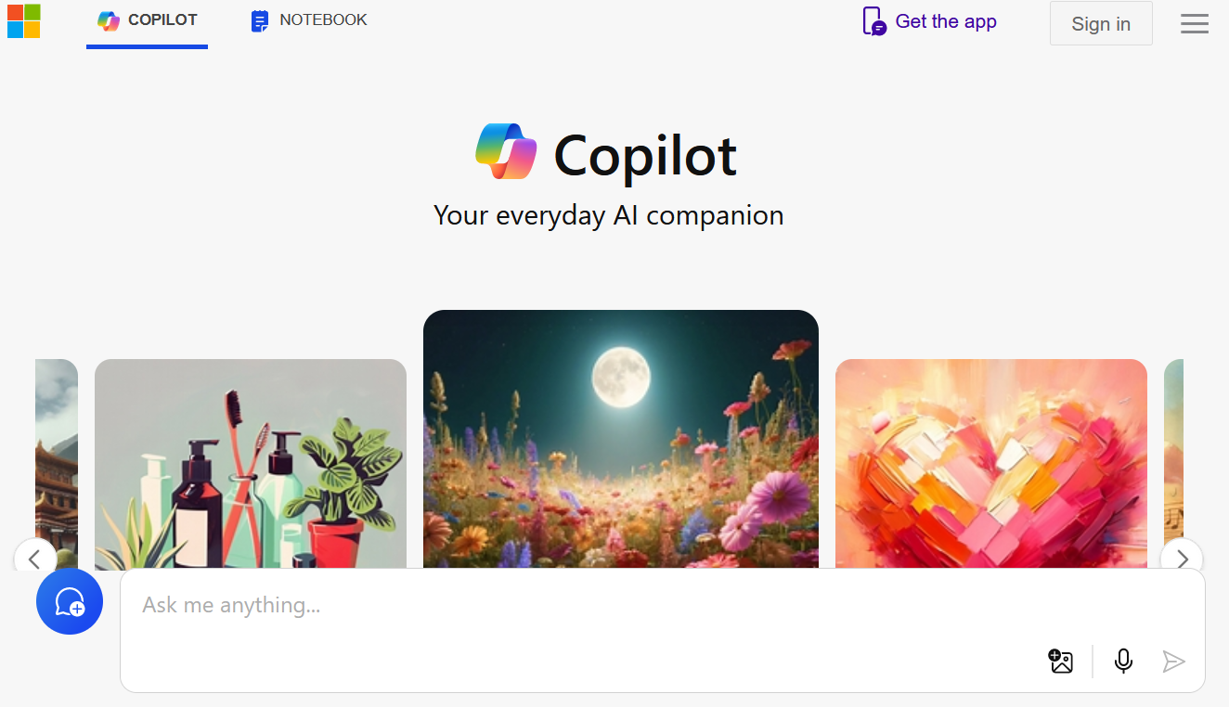
Recommended AI Tool
Based on a Privacy Impact Assessment completed at UBC, recommend Microsoft Copilot WITH your VCC student login. Use for low-risk information (e.g. publically available, non copyright info; nothing confidential/personal security risk).
Notes:
Here you could also say this is the only tool ALLOWED for course work if htats part of your permisisons
Or recommend it as part of helping students say safe privacy/data wise in their own choices.

Slide 19
Using copilot SAFETY REMINDERS
Login at copilot.microsoft.com using your @student.vcc.ca email address. This version prioritizes advanced privacy measures by anonymizing session data and ensuring that data will not be used for AI model training.
Sign in to Copilot using your VCC email and password.
Do not enter personal or private information, or information you do not own such as PDFs of others’ copyright work. Do not share any information that you would not publish on the internet. Anything you enter may be shared as results to other users.
Avoid clicking the “Like” and “Dislike” icons to give feedback on a response. Clicking either icon risks unintentionally sharing the chat session data with Microsoft.
Start a new topic to clear the chat history when you are done with a chat. Click the “New Topic” icon near the ‘Ask Me Anything’ box. Starting a new topic ensures that all temporarily stored prompts and responses from the current chat session are discarded from the cache.
If using Edge sidebar copilot, turn off access to webpages when not needed.

Slide 20
Resources
When in doubt, ask!
Ask me if you have any questions or concerns about the use of AI tools in an assignment. If you have questions about how to cite AI tools, you can make an appointment with a VCC librarian or see the VCC citation guide.
Remember, GenAI permissions will be different for each class. Be sure you understand the situation for each of your courses!
University of Saskatchewan Academic Integrity and AI interactive module University of Technology at Sydney student created guide on using AI responsibly and productively
AI prompts for studying

Slide 21
Reflection: What did you learn? What questions do you still have?
Notes:
Consider a follow up written submission, recording about feeling about GENAI now.

Slide 22
Resource: Is it safe and ethical to use GenAI?
Notes:
*may wish to hand this flowchart out

Slide 23
YOUR Responsibility WHEN using ai
Academic Integrity. Follow course policy on use.
Citation (if/when AI use is permitted)
Any information taken from a GenAI tool needs to cited! These include MLA, APA, and Chicago Style.
If required, copy and paste all AI interactions at end of assignment or a statement describing which tools were used and how they were used in creating the assignment.
Critical Analysis (if/when AI use is permitted)
If it’s in your work, you are responsible for it (accuracy, appropriateness, currency, bias, etc.). Evaluate your sources.
Notes:
This slide is about the STUDENT”S Responsibility in using AI

Slide 24
My (Instructor) commitments on AI use
Provide transparent communication on each assignment about when/how/why you can use GenAI
Provide alternatives to address concerns and/or access issues (you will not be mandated to use AI)
Provide resources around AI literacy
Follow ethical use such as not submitting your assignments to GenAI for grading purposes and not using AI detectors
Be transparent about my own use of AI in creating course content.
Answer questions about concerns about AI use and academic integrity
Notes:
This is a slide where you may comment on your commitment to how you will ethically, transparently use AI in the course

